Slide 1

Library Management System
Project Presentation
Date: 18/04/2025
Major Project ( ICI651) Degree : BCA - CTIS
SUBMITTED BY:
Deepak saini
Aryansh
Project Guide:
Mr. Aatish Kumar Baitha
Mr. Umesh Chandra Garjola
(TCA2256018) (TCA2256014)
Gaurav Chaubey (TCA2256025)
Hitesh Kumar (TCA2256031)
FACULTY OF ENGINEERING & COMPUTING SCIENCES TEERTHANKER MAHAVEER UNIVERSITY, MORADABAD

Slide 2

Team Details
Student Name | Role
Deepak saini | Developer
Gaurav Chaubey | Testing/Quality Assurance
Aryansh | Database Administrator
Hitesh Kumar | Maintainer
Guidelines: Mention Team Names & their role in project
2

Slide 3
Project Brief
. A Python-Tkinter-based Library Management System
. Manages library tasks: Add, Delete, Issue, Return books
. Stores transaction records in a local SQLite database
. GUI simplifies operations for librarians
Guidelines: Mention brief about the project and it’s functions/ modules

Slide 4
. Language: Python
. Frontend: Tkinter (GUI Toolkit)
Methodologies/ Technologies/ Tools to be used
. Database: SQLite
. IDE: VS Code
. Structure: Modular Python files (AddBook,
IssueBook, etc.)

Slide 5
Context Diagram (Overall Project)
Student Database
Reply
Staff
Reports
Suppler
Request
Stock
Students info
Library Management System
request
Reports
Students
reply
Management
availability
Book Details
Book Daabase

Slide 6
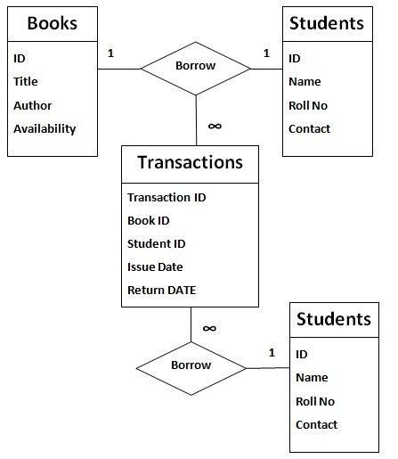
Entity Relationship Diagram (ERD)
Student Book
StudentID ^{BookId}
_{Name} Title
Contact ^{Author}
IssueRecord _{Status}
IssueID BookID StudentD IssueData RetruenDate

Slide 7
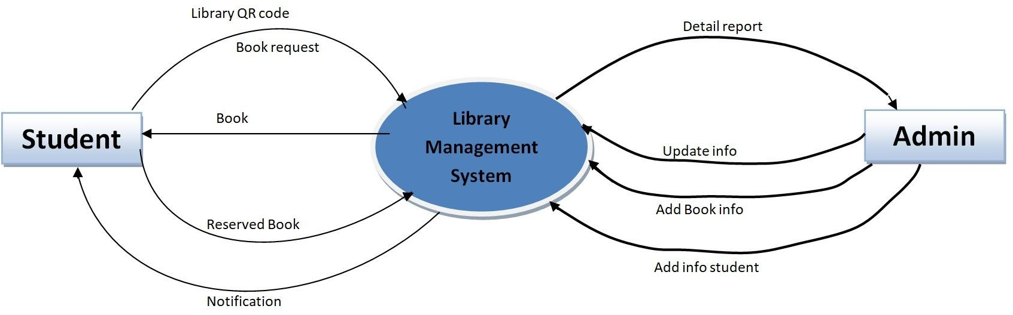
Data Flow Diagram (DFD)
0 Level Data Flow Diagram :
Guidelines: Add more slides, if required to show all DFDs

Slide 8
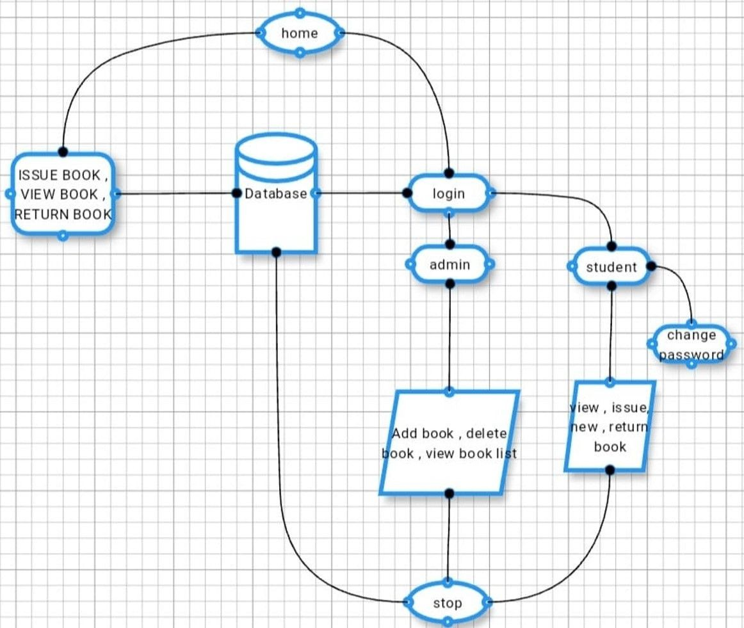
Flow Chart
Guidelines: This slide is optional

Slide 9
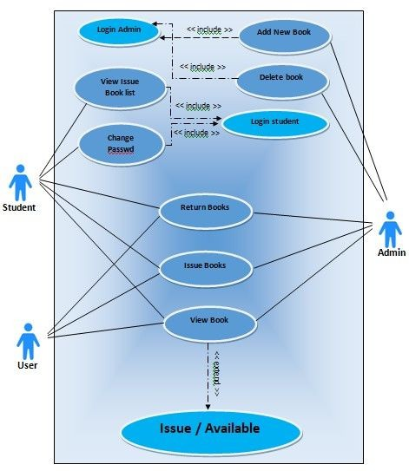
Use Case Diagram
Guidelines: This slide is optional. May add more slide, if the details are available
9

Slide 10
.
.
Advantage of The Project
\
Easy to use and manage library records
Replaces manual bookkeeping Lightweight – no complex DB setup Saves time and reduces errors
.
.
Guidelines: Mention advantage from this project, the audience/ users who will get benefitted

Slide 11
References
. Python Docs: https://docs.python.org
. Tkinter Guide: https://tkdocs.com
. SQLite: https://sqlite.org

Slide 12
THANKS

